Slide 1
Layered Architecture

Slide 2
Architecture defines system, interfaces, and interaction patterns
Layered architecture aims on understanding a comprehensive approach to software architecture for large-scale systems.
Architecture affects how software is designed and structured and therefore also substantially influences the characteristics of the software systems.
In an object-oriented system where implementation classes are organized in subsystems, the Software architecture defines the static organization of software into subsystems interconnected through interfaces and defines at a significant level how nodes executing those software subsystems interact with each other.
(Garlan and Shaw,1993; Shaw and Garlan, 1996) defines
  “the architecture of a software system defines in terms of computational components and connections among those components.”

Slide 3
A good architecture is crucial to maintain system integrity
Choosing the right architecture is one of the most important decision a software engineering business can make. Software architecture is important in order to maintain the integrity of systems so that development and maintenance do not result in a patchwork of uncoordinated fixes.
With the right architecture in place, software engineers can design and implement the system more effectively and more predictably.
A good architecture act as a guide to which components should be reused during the development of application systems.
A good architecture allows the component and application systems to evolve gracefully over time.
The architecture must be defined and described in such a way that it can be easily modified and improved as new and changed requirements are implemented.
A well-defined architecture, with explicit interfaces, can reduce this communication overhead since the architecture will provide the developers most of what they need in order to understand what others are doing.

Slide 4
A layered architecture organizes software according to generality
Application systems can be built from component systems.
Component systems may in turn be built from other component systems in lower layers.
All the layered systems are composed of application systems at top and component systems underneath.
layered architecture in a software architecture organizes software in layers, where each layer is built on top of another more general layer.
A layer can loosely be defined as a set of (sub)systems with the same degree of generality. Upper layers are more specific, lower are more general.
By software organization, we mean that the layering addresses how static constructs such as modules depend on each other at compile and link time.

Slide 5
A layered architecture organizes software according to generality
Cont…
The number of layers, their names and their contents are not fixed, but vary from situation to situation. Examples:
  Application system layer- should contain one application system for each software system that offers a coherent set of use cases to some end users.
  Business-specific layer- contains a number of component systems specific to the type of business. Such components systems offer use case and object components to the application engineers to build application systems and are often reusable by the application systems developed by a particular reuse business.
  Middleware layer- offers component systems providing utility classes and platform-independent services such as distributed object computing in heterogeneous environments. This layer often contains component systems for GUI builders, interfaces to database management systems, platform-independent operating services, ORBs, and OLE-components such as spreadsheets and diagram editors.
  System software layer- contains the software for the computing and networking infrastructure, such as operating systems, interfaces to specific hardware, and so on. However, it is increasingly the case that specific operating system provide mechanisms for platform-independent access to services offered by system software.

Slide 6
Layered architecture
Variants of a particular application system
Distinct application systems- each application system offers a coherent set of use cases to one end users.
Business- Specific
Application Systems
Application domain and organization specific- contains a number of component systems specific to the type of business
Platform independent distributed object computing- offers component systems for utility classes and platform independent services for things like distributed object computing in heterogeneous environment.
Middleware
System Software
Platform specific- contains the software for the actual infrastructure such as OS, interfaces to specific hardware, and so on.

Slide 7
Example: XYB Layered system
Different application systems such as ATM Cashier and Payment can be built from the business- specific component systems Money Management, Account Management, Bank Customer Management, and Invoice Management. Several of the application systems developed by XYBoft, such as Payment and Invoicing, may need to execute on different machines and hence need to interoperate using middleware component systems such as Java and HP ORB Plus. At the lowest level, XYBoft will build on commercial system software such as NT Workstation (on the desktop of managers and clerks) and TCP/IP.
Application Systems such as Payment and invoicing help a Bank Customers perform the XYB business processes such as Sales From Order To Delivery.
In this process, a Buyer first orders some goods or services, then the seller invoices the Buyer, then the buyer pays, and the seller delivers the goods or services, either before payment or after.

Slide 8
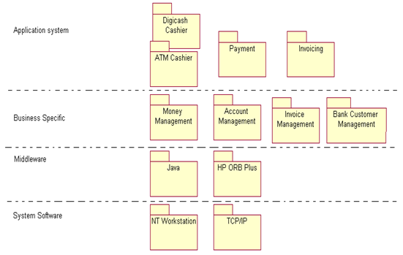
Example: XYB Layered system
Cont…

Slide 9
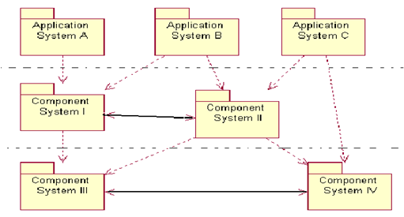
Cont…
Layered architecture
A layered system has both a horizontal “ dimension” for systems interacting within the same layer and a vertical “dimension” for static dependencies across layers.
System dependencies(dashed arrows) and interaction (full arrows) in a layered system. System in one layer may not depend on systems in higher layers.

Slide 10
A layered architecture reduces software dependencies
A layered architecture allows software to be organized in layers according to application specificity.
A layered architecture is intuitive enough to be understandable to someone without deep software engineering knowledge. This is very important since it allows for discussion of the architecture, operation, and performance of the reuse business in high-level terms.
Some of the metrics are:
  Degree of reuse of/from component systems in different layers;
  Initial and maintenance cost for the development or purchase of a specific component systems;
  Initial and maintenance cost for the development for the application systems- compared to the cost before installation of the reuse business.
  Time required for initial and further development of a specific component system;
  Time required for initial and further development of an application system, compared to time required before installation of reuse business;
  Quality of component systems;
  Quality of an application systems, compared to quality level experienced before installation of reuse business.

Slide 11
The middleware layer supports distributed object computing
Large organizations grow more and more dependent on enterprise-wide information systems, which need information to support them in a globalized, highly competitive market.
To complete effectively, companies require agility- the ability to change processes and supporting information systems quickly.
There is growing virtual organizations, distributed teams, cross-organization support, and telecommuting.
This requires support from distributed enterprise information system, which is independent of physical location.
The interoperable distributed object computing is an important step towards globalized enterprise information systems.
The classical programming languages (C++,C etc.) are limited to executing in one fixed address space, bound to one language.
In contrast, interoperating distributed object are written in a variety of languages and these are distributed across networks and are supported by a variety of services for persistence, security, and naming.

Slide 12
The middleware layer supports distributed object computing
Cont…
This requires a platform with a mechanism for marshaling messages to objects that are localized in a different address space, possibly on the other side of the world on a different type of workstation, running a different operating system.
Marshaling here means encoding and decoding messages and parameters to and from a flattered from that can be transmitted across a network.
There are several different emerging standards, such as Microsoft’s COM/OLE and OMG’s CORBA augmented with CI Labs OpenDoc.
The CORBA/OpenDoc and COM/OLE techniques both map well to the RSEB approach.

Slide 13
CORBA
The Common Object Request Broker Architecture(CORBA) is a vendor interoperability standard designed to allow interoperability between components regardless of the platform, language, author, or vendor infrastructure.
An Object Request Broker(ORB) is an implementation of the CORBA standard and is responsible for transparently marshaling and forwarding messages to objects distributed in heterogeneous environments (OMG, 1996e).
A key part of the CORBA specification is a language-netural Interface Definition Language(IDL).
IDL gives a precise description of types and exceptions and is similar to C++ interface and type declarations but permits multiple language bindings.
CORBA objects can have multiple interfaces, perhaps composed or inherited from other interfaces.

Slide 14
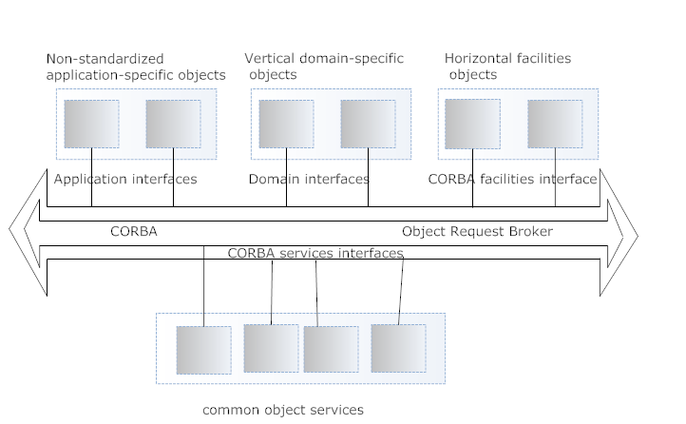
CORBA
Cont…

Slide 15
Example
Several of the application systems offered by XYBsoft such as Payment and Invoicing may execute on different machines and need to interoperate via distributed objects. One way to achieve such object distribution is to use an ORB. For Payment and Invoicing application systems, this means that, for example, the Account and Invoice objects need to be distributed objects.
Note that the ORB is itself a component system in the middleware layer, while the Account Management and the Invoice Management component systems belong to the business-specific layer.

Slide 16
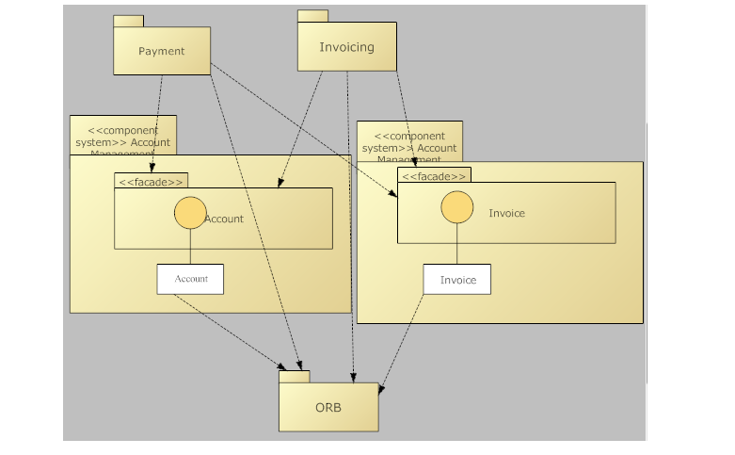
Cont…
Account and Invoice need to be distributed objects, which is achieved using an ORB that publishes the Account and Invoice interfaces. Several <<imports>> dependencies are shown.

Slide 17
OpenDoc
OpenDoc is a compound document architecture, implemented as a set of compound document components and services, aimed at development of rich user interfaces and document-oriented applications.
The component classes, called parts, implement a rich compound document framework.
The OpenDoc model is based on IBM’s SOM, itself based on OMG’s CORBA standard.
The OpenDoc model is completely object-oriented and allows new components to be created by subclassing and also by wrapping and aggregating other components. Furthermore, OpenDoc claims to be OLE compatible.

Slide 18
OLE/COM and ActiveX
OLE(Object Linking and Embedding) started out as a rather complex mechanism for allowing Microsoft Office products to share parts of documents, such as embedded spreadsheets in documents.
OLE is based on an underlying Component Object Model(COM).
OLE/COM defines an architectural style for components(the component definition model), and provides several services such as compound document objects, structured storage, uniform data transfer, and OLE automation and scripting.
OLE components are accessed through OLE Control Component(OCX) interfaces, now more correctly called ActiveX.
An ActiveX interfaces is a collection of function(sometimes called method or member functions) that reusers can connect software to.
From an RSEB point of view, all this means that interfaces to OLE components can be defined using facades and UML interfaces, but they are somewhat less elegant than the corresponding CORBA interfaces would have been, and they do not support multiple language bindings.

Slide 19
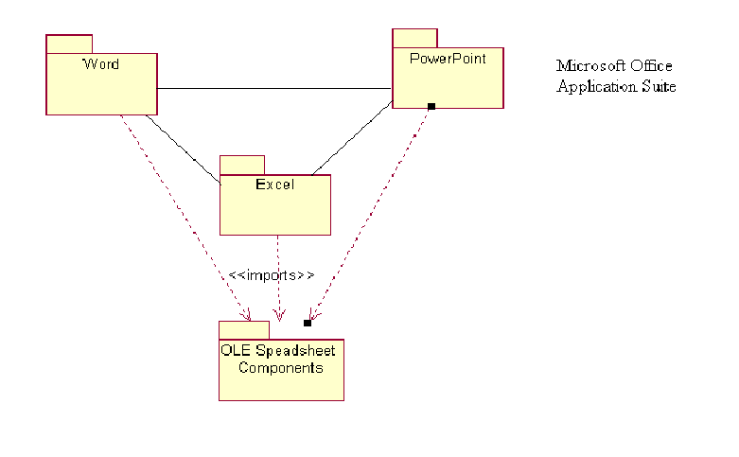
Example
Application system in a Microsoft office suite that reuse a common OLE spreadsheet component system.

Slide 20
Comparing ActiveX/OLE/COM to CORBA/OpenDoc
The evolution of OLE and ActiveX has been driven from its use in the office application, the Visual Basic community, and now the internet community.
CORBA has evolved in steps as a standard for large-scale object distribution that allows vendor to implement their own products.
The Taligent CommonPoint frameworks and the Tekneron Rendezvous software bus are two such examples.
  Comparison of ActiveX/OLE/COM and CORBA/OpenDoc

Slide 21
Attributes | ActiveX/OLE/COM | CORBA/OpenDoc
Component system | Separate component systems for each set of components, for example spreadsheets. Components represented as object type or classes or perhaps services packages. | The ORB is one components systems and each additional set of services is a separate component system. Component systems are organized in subsystems or services packages.
Application systems built by | Using OLE and DCOM to access components through their interfaces as OLE servers, embedding ActiveX components in web browsers and other containers, adding extra functionality with a scripting language. | Accessing components through an ORB without bothering about object location. Using OpenDoc components for rich UI and document-oriented applications.
Facade | Facades contain interface specifications and ActiveX/OCX’s components that can be customized. | Facades contain IDL specifications.
Interfaces | OLE IDL, which defines interfaces as collections of functions. | OMG IDL- similar to C++ .h files.
Variability mechanism | Parameterization, generation, and aggregation. | Inheritance and aggregation.
Distribution mechanism | DCOM, Internet | An ORB
Middleware layer | As defined by DCOM, ActiveX, OLE services | The ORB, Object services, Common Facilities, Common components for compound documents.
System software layer | Windows NT, Windows 95, some interoperability services provided on UNIX. | Each ORB should be capable of existing on multiple platforms, or interoperating with ORBs from other vendors.

Slide 22
The business-specific layer supports rapid application development
This layer contains all the component systems that are specific to the business, but reusable in several applications.
It is primarily these component systems that should be used by application engineers.
The component systems in the business-specific layer capture and implement business-specific domain knowledge.
These component systems are highly valued assets for the reuse business because they can support the organization as they use its knowledge to compete with other companies.
In RSEB, business objects are supported by software in one or more component systems within the business-specific layer.

Slide 23
Example
The Account Management component system contains a Risk component. Risk is used to allow bank customers to estimate the risk they are exposed to on their accounts, for instance when an Account holds a foreign currency. The Risk component implements business rules that reflect XYB’s understanding of how to estimate these kind of risks. XYBsoft knows that XYB has good understanding of how to assess risks of these kind and therefore hopes to attract further customers by offering new banking services associated with Risk Management.

Slide 24
Cont…
In a recent request for proposals (OMG, 1996a), OMG Business Object Management Special Interest Group (BOMSIG) define a business object as follows: “a business object is representation of a thing active in the business domain, including at least its business name and definition, attributes, behaviour, relationships, rules, policies and constraints. A business object may represent, for example, a person, place, event, business process or concept. ”
Some authors use the term business component rather than business object.
We define a business object as representing something concrete and significant in the business- a representation of members of the business or “some thing” handled or used by people in the business (Jacobson et al., 1994)

Slide 25
Example
The Account business object was identified while XYBsoft’s business engineering experts analyzed their business. As the XYBsoft Application Family Engineering team defined the layered system, they suggested a component system Account Management to support account related functionality.

Slide 26
Contents of the business-specific layer on similarity among application systems
The business-specific layer should contain components that allow application engineers to work effectively.
Table provides some guidelines as to which type of components should be most useful to develop application systems with certain characteristics.

Slide 27
Contents of the business-specific layer on similarity among application systems
Cont…
Characteristics of application systems | What they will reuse from business-specific layer
Independent applications with some common components and features | Some common entity types and related classes
Interoperating, but fairly different | Many entity types
An interoperating, integrated application suite | Some concrete and some abstract use cases. Most entity types, major boundary types, and some control types and classes
Separate applications that are built as customizations of a base of generic application functionality | Some concrete and many abstract use cases. Most types and classes are reused and specialized from common component systems
Interoperable applications that are built as customizations of a base of generic application functionality | Some concrete and many abstract use cases. Most types and classes are reused and specialized from common component systems. Many types and classes are also reused as-is

Slide 28
Example
The application systems Payment and Invoicing communicate with each other during the process. Sales From Order To Delivery.
The business process of Sales From Order To Delivery is supported by the Pay And Schedule Invoice use cases in the Payment application system and the Receive Payment use cases in the Invoicing application system.
The use cases Pay And Schedule Invoice allows the Buyer to study invoices and decide whether, when and how to pay them by issuing a request to the use case to schedule invoice payment. The Receive Payment use cases inform the Seller when invoices have been paid and keeps track of outstanding invoices, helping the Seller take action on them. The abstract use case Monetary Transfer is refused from the Account Management component system.
Both the Invoicing and Payment application systems also reuse object components from the component systems Account Management and Invoice Management. These components include entity for Invoices and Accounts, but also control types that care of money transfer and processing an invoice payment. This means that the component systems Account Management and Invoice Management offer abstract use case components and some concrete entity and control objects. This is a common pattern. These concrete objects act as a shared communication objects when integrating interoperable application systems.

Slide 29
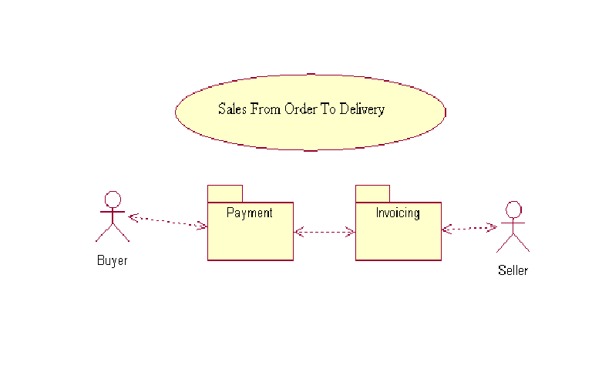
Example
The Application systems Payment and Invoicing support Sales From Order To Delivery.

Slide 30
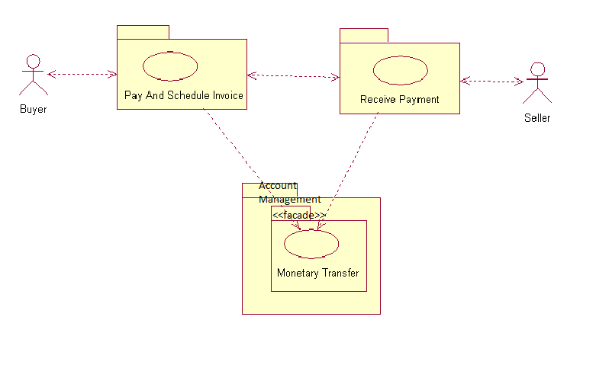
Example
Figure 7.8 The use cases Pay And Schedule Invoice and Receive Payment reuse the Monetary Transfer use case.

Slide 31
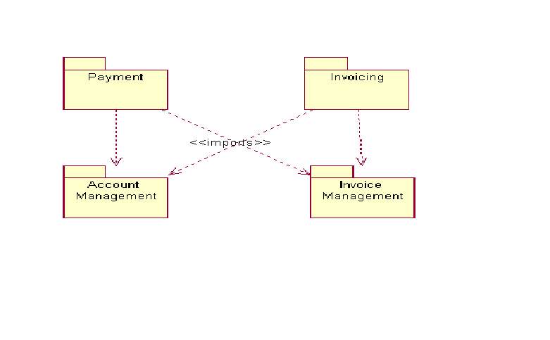
Example
The Payment and Invoicing application systems reuse use cases, entity and control objects from Account Management and Invoice Management

Slide 32
Using multiple models when working with layered system architecture
Software architecture needs to take into account both the static organization of software and how that software manifests itself in executing systems.
An object-oriented software architecture thus also defines the allocation of object instances to processes, process interaction, and the allocation of processes to nodes.
The allocation of use cases to types, classes and processes and the performance of those use cases are also important to consider, even if the use cases themselves are not part of the architecture.
Kruchten (1995) proposes five main views of a system which are useful and often necessary to develop architectures.
Kruchten’s views correspond very well with the models.

Slide 33
Using multiple models when working with layered system architecture
They are used as follows:
The concurrency model captures concurrency, processes, and synchronization aspects.
The deployment model describes the mapping(s) of the software onto the hardware and reflects its distributed its distributed aspects.
The design model and implementation model describe the static organization of the software in its development environment.
The analysis model is used to represent and outline the most essential objects in the business; this is not part of the architecture per se, but is used to better understand what the architecture represent.
The use case model defines the most important use cases that span across several application systems. While not part of the architecture per se, it is used to better understand what the architecture represents. The use cases are used to define how the elements of the elements of the architecture need to interact.

Slide 34
Using multiple models when working with layered system architecture
Note that only the concurrency, deployment, design, and implementation model are used to represent the layered system.
All these models contain only architecturally significant elements, which means that they are abstractions of the models of the individual application and component systems that comprise the layered systems.
The key difference is that architects think of the whole layered system as one system.
We call this a system interoperating application and component system (SIS).

Slide 35
7.8 Representing a layered system as a superordinate system
The layered system is treated as a system in its own right, a system that defines the interoperating set of application and component systems as a whole.
This system is called superordinate systems since it provides the big picture of the whole layered architecture, and corresponds to subordinate application and component systems.
The models of the superordinate system are called superordinate models, consisting of superordinate use cases, subordinate subsystem, and so on.
The idea is thus to develop a complete OOSE model for a layered system in two steps of abstraction:
  The first step treats the family of applications as if it were in fact a single superordinate system, ensuring end-to-end consistency.
  The second step develops models with much more detail for each of the individual interacting application and component systems.

Slide 36
Using multiple models when working with layered system architecture
The superordinate system is described with several models that together represent both the static and dynamic aspects of the layered system as a whole.
By representing the layered system as a single superordinate system separate from the individual application and component systems, it is possible to:
  Represent only the part of the architecture that is most significant to the Application Family Engineering team as a group;
  Manage the architecturally most important aspects of the layered systems as a product, since it is represented as s system
  Coordinate the different views of the layered system as a whole- by treating the different views as models of a system, we can use OOSE guidelines on managing the connections between the views;
  Use similar software engineering processes and tools to work with the overall layered system and applications;
  More easily train skilled application engineers to work with architectures.

Slide 37
Using multiple models when working with layered system architecture
A system of interoperating systems is a system that is implemented by a set of interoperating systems.
The systems A and C are application systems and B is a component system, described by their own set of use case and object models.
The fact A, B, and C are interoperating systems maintained by individual teams stresses the importance of keeping the models of those systems compatible with each other.
Such a interoperating systems can be also be represented as a single system S.
Each one of A, B, and C is now represented by a corresponding subsystem, a, b, and c in S.

Slide 38
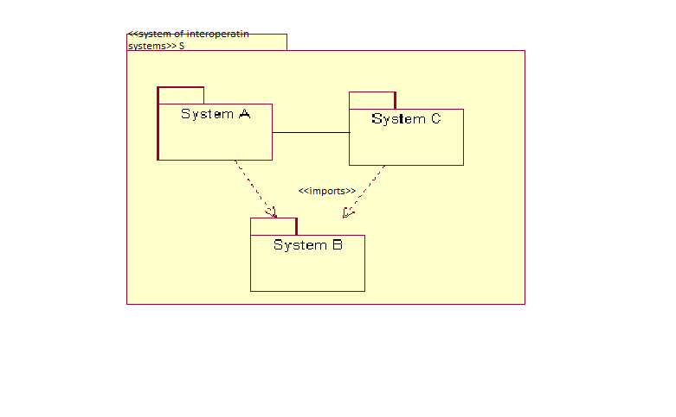
Figure 7.10 A system of interoperating systems.

Slide 39
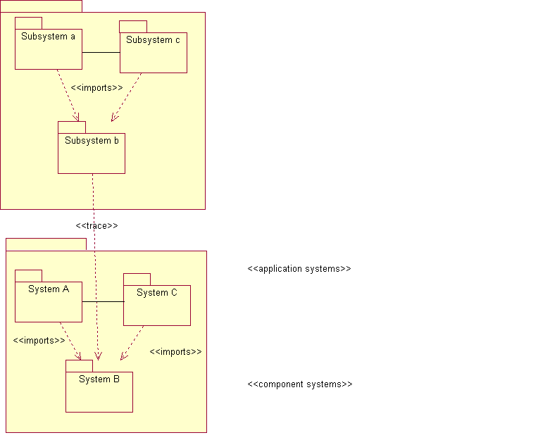
Figure 7.11 in the superordinate system, the application systems A, B, and C are represented by design subsystems a, b, and c

Slide 40
Using multiple models when working with layered system architecture
One of the main reason for breaking down the layered system into separate application and component systems is to allows independent, yet manageable, development of these systems.
Each application and component system therefore has its own set of use case and object models, while architects have their own superordinate models which provide the overall view used to define the dependencies among application and component systems.
The architects, the Application Family Engineering team, are therefore responsible for defining interactions and interfaces between application and component systems and facades provided by the component systems.
The Application Family Engineering team needs to be careful not to make the superordinate models more detailed than needed for this overall view.

Slide 41
Using multiple models when working with layered system architecture
Rational training course (rational, 1995), suggest what to include:
  Superordinate system use cases that capture most of the collaborations involving more than one application system, and some interactions that involve both an application system and component systems.
  Some important abstract use cases or key mechanisms.
  Major object types and classes, but not most subtypes or subclasses.
  Types and classes that have high visibility, or that are core to the domain, typically corresponding to analysis types.
  All subsystems and exported interface, but not all individual classes or modules.
  All facades and their contents.
  All processes.
  All node types.

Slide 42
Example
As the Application Family Engineering team works on the Account Management component system, they envision several types and classes for transaction fees that implement different ways for the bank to charge the customers as they perform transactions.
However these classes are not visible to application engineers working on applications such as Digicash Cashier, Payment and Invoicing.
Instead, these classes will only be used by other types and classes defined within Account Management.
These transaction fee classes are therefore not deemed significant enough to be represented in the superordinate models.

Slide 43
Using multiple models when working with layered system architecture
The superordinate design model contains a subsystem for each application and component system.
The subsystems are connected with <<trace>> links to the corresponding application and component systems.
The design model of the superordinate system is used to:
  Define the application systems on a high level and define how they interoperate;
  Define the reusable design classes, types, and subsystems and organize them in component systems;
  Define the component system facades and also to detail which systems import from which facades;
  Allocate use cases defined in the models of the superordinate system to the application and component systems.
The design model and the superordinate system is organized in non-overlapping layers to reflect the layering of the application and component systems.
The term “layer” is only important as an architectural pattern that conveys a simple image of the superordinate system- the precise picture of the intersystem dependencies can only be understood by looking at the subsystem dependencies.

Slide 44
Example
The business process of Sales From Order To Delivery is supported by the interoperating Payment and Invoicing application systems.
Both Payment and Invoicing reuse the Account component defined in the component system Account Management.
The design model of the superordinate system contains a subsystem for each of the application and component systems. For example, the application systems Payment and Invoicing are represented as subsystems in the Application Layer, and the component system Account Management is represented as a corresponding subsystem in the Business-specific Layer.

Slide 45
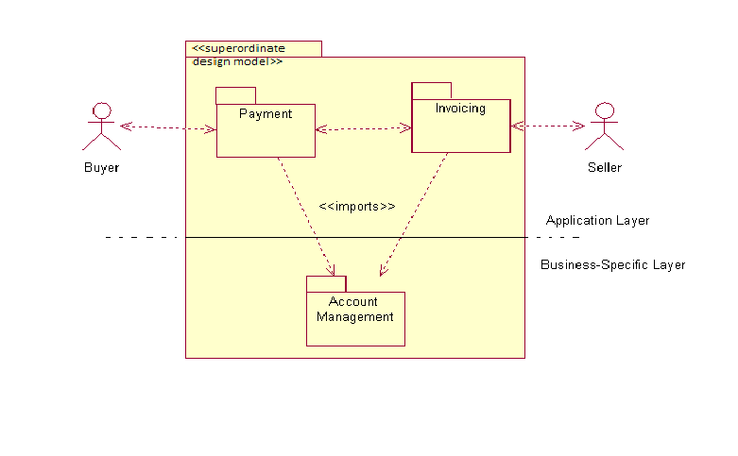
Figure 7.12 one design subsystem in the superordinate design model for each of Payment, Invoicing, and Account Management, organized in layers.

Slide 46
7.9 Use cases in relation to a layered system
The interaction between interoperating application and component systems is defined in terms of use cases that span across several interoperating systems in the layered system.
We represent such use cases as superordinate use cases in the superordinate system.
Each superordinate use case can be allocated to the application and component system, by splitting them across these systems.
This involves two steps:
First, allocate the use cases to design subsystem in the superordinate system.
A part of use case allocated to an individual subsystem is called a use case segment.
Then the superordinate subsystems are used to define the responsibilities of the corresponding application and components system.

Slide 47
Use cases in relation to a layered system
Each application or component system will in turn offer a number of use cases that correspond to the use case segment allocated to the subsystem in the superordinate design model.
Together, the set of application or component system use cases offer behavior that is equivalent to the superordinate use cases.

Slide 48
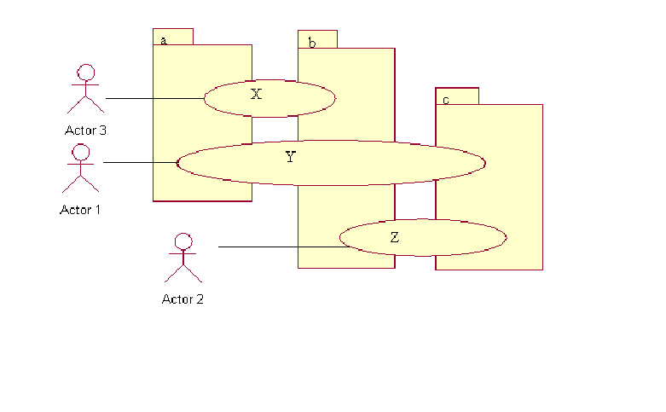
Figure 7.13 The superordinate use cases X, Y, and Z are allocated to the subsystems a, b, and c. Different segments of each use case are assigned to each subsystem.

Slide 49
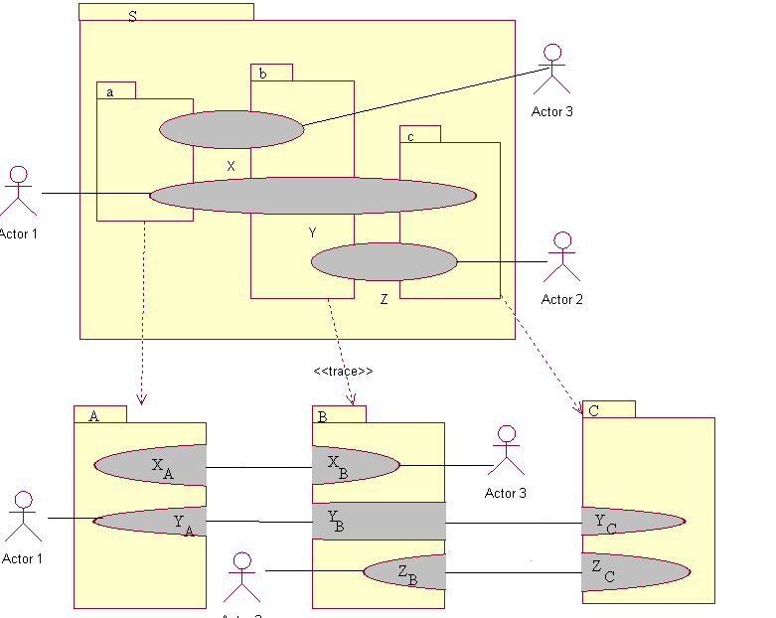
Figure 7.14 each use case (such as X) in an application or a component system corresponds to a segment of a superordinate use case(such as X). Note that the system’s application and component systems, A, B, and C, and the superordinate systems, S, are each treated as separate systems with their own unique models.

Slide 50
Example
The business process of Sales From Order To Delivery is supported by the interoperating Payment and Invoicing application systems. Together, these application systems perform the superordinate use case Pay Invoice, which handles payment of issued invoices. The Pay Invoice use cases is responsible for assisting the Seller to issue invoices, supporting the Buyer in deciding which and when to pay, and then making sure that money is transferred from the Account of Buyer to that of the Seller.
The superordinate Pay Invoice use case is divided between subsystems that correspond to the application system Payment and Invoicing, and the component system Account Management. Together the use cases Pay And Schedule Invoice and Receive Payment perform a behavior that is equivalent to the defined by the superordinate use case Pay Invoice.
Note that the superordinate use case Pay Invoice need only be described at a level where the subsystem interfaces can be defined.

Slide 51
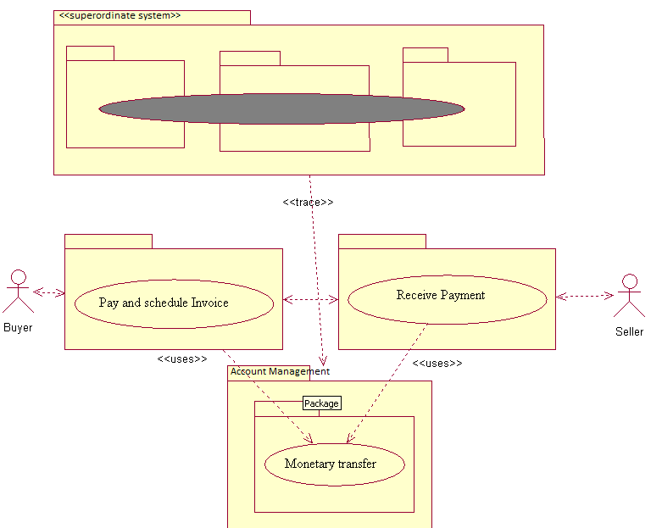
Figure 7.15 The use cases Pay And Schedule Invoice and Receive Payment together perform the Pay Invoice use case defined for the superordinate system.

Slide 52
7.9.1 Describing use cases for the superordinate system
Each use case in superordinate system is comprised of superordinate transactions that may involve more than one application and component system.
In principle, the use case model for the superordinate system could define all superordinate transactions.
Sequence diagrams can be used to define how each use case for the superordinate system is divided among the design subsystems that correspond to the application and component systems.

Slide 53
Example
The use case Pay Invoice could have an (oversimplified) description something like the following:
The Buyer activates the use case. The system presents the invoice that have not yet been paid.
The Buyer choose which invoices to pay and decides when to pay them.
The system registers the payment orders and at the time executes payment of the invoices, by deducting the amount from the account of the Buyer and transferring it to that of the Seller.
As an invoice is being paid, a message is sent to the Seller and a receipt is sent back to the Buyer.

Slide 54
Example
Pay Invoice involves the interactions between application and component systems.
A selection of the available Invoices is fetched. One or more Invoices are chosen and scheduled for payment.
Later, when a scheduled Invoice is due for payment, Invoice Management is invoked by timer and the Invoice is paid by transferring money from the account of the Buyer to that of the Seller.
The Invoice state is set to paid and Invoicing and Payment are informed via the notification Invoice paid.

Slide 55
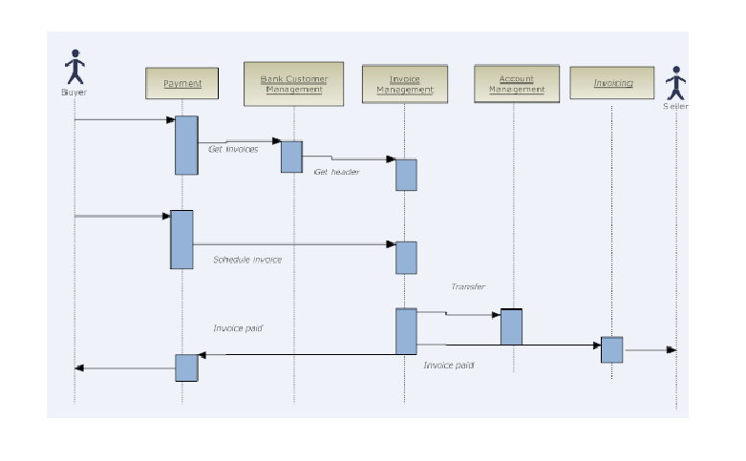
Figure 7.16 A sequence diagram describing the flow of Pay Invoice.

Slide 56
7.9.2 Using interfaces for more explicit separation of system responsibilities
The static structure of the interface may be defined using, for example, IDL or C++ .h files and the dynamic structure may be further defined using, for example, UML diagrams.
Example
The Invoice component offered by Invoice Management allows peers to register for notification on the state change of an Invoice, using the Invoice Tracking interface to the Invoice component. This is used, for example, by Invoicing after it has created a new Invoice to the Buyer, to allow the Seller to register for notification on paid and overdue invoices. The creation of the Invoice object results in a notification to the actor Buyer. The Buyer then uses the Payment application to pay the Invoice which notifies the Seller.
Note that the Invoice and Invoice Tracking interfaces are exported in the façade for reuse, not the Invoice type itself;
The Invoice Tracking interface to the Invoice Management component system would be defined in IDL roughly as follows:

Slide 57
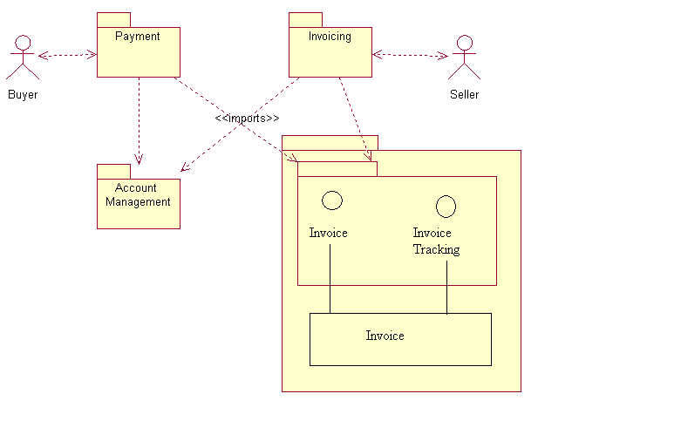
Figure 7.17 The Payment and Invoicing application systems reuse the Invoice Tracking interface of the Invoice Management component system.

Slide 58
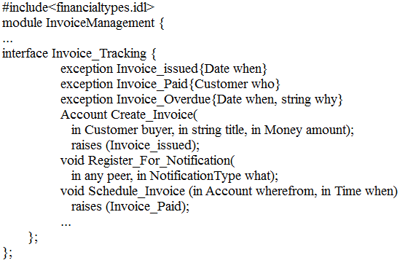
Example cont…

Slide 59
Cont…
As an example, Payment could instead supply an interface which Invoicing could use to register a new Invoice to be paid.
Only the Application Family Engineering team is allowed to change the facades and the interfaces between systems.
In fact, the interfaces between the application and component systems must be identical to the interfaces between the subsystems in the superordinate design model to maintain consistency.

Slide 60
7.10 Actors of the application and component systems
Each application and component system may interact with both end users and other application or component systems.
Since each application and component system detail a subsystem defined in the in the superordinate system, it has to be capable of interacting with the same environment.
Therefore each application and component system must have actors that correspond to:
  All actors that the corresponding subsystem in the superordinate model interacts with, and
  All subsystems in the same layer that the corresponding subsystem interacts with.

Slide 61
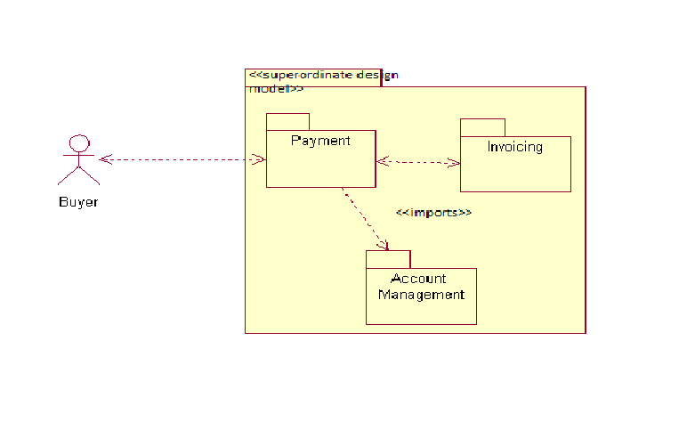
Figure 7.18 The Buyer actor plus the Invoicing and Account Management subsystems constitute the environment of the subsystem Payment.

Slide 62
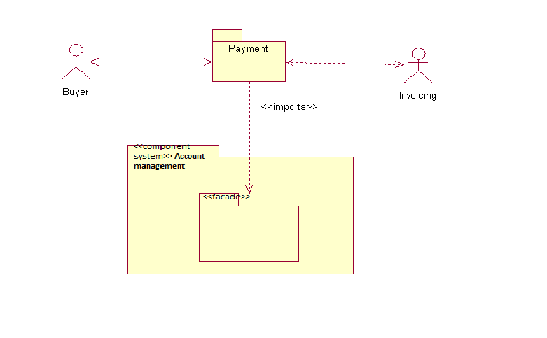
Figure 7.19 The application system Payment interacts with the Buyer and Invoicing actors and imports from a façade of the component system Account Management.

Slide 63
Example
The Payment subsystem in the superordinate design model interacts with the Buyer actor and the Invoicing subsystem. It also imports from the Account Management subsystem in the lower layer.
Both the superordinate Buyer actor and the superordinate Invoicing subsystem will be represented as subordinate actors of the application system Payment .
Reuse from the component system Account Management is expressed as an import from a facade.

Slide 64
7.11 use cases for the application and component systems
Each application and component system may have its own use case model.
Use cases defined for the super ordinate system can be “composed of” use cases defined in application and component systems.
It is simplest when one super ordinate use case corresponds to one use case in each application and component system involved, but it is sufficient for the application and component system to offer use cases that somehow work together to behave equivalently to the super ordinate use cases.

Slide 65
Example
The superordinate use case Pay Invoice is decomposed into use cases for the component (or application) system as follows. This super ordinate use case involves the subsystems Invoice Management and Account Management. These corresponds to component system with the same names.
The behavior depicted results in the definition of two abstract use cases in the Invoice Management and Account Management component systems. Get Header and Monetary Transfer.
Monetary Transfer is reused in the Payment and Invoicing application systems. Note that both of the use cases defined for the component systems may also be” involved: in other superordinate use cases.
Once we have decomposed the use cases and defined the subordinate actors and use cases for each subordinate application and component system we can model each system.

Slide 66
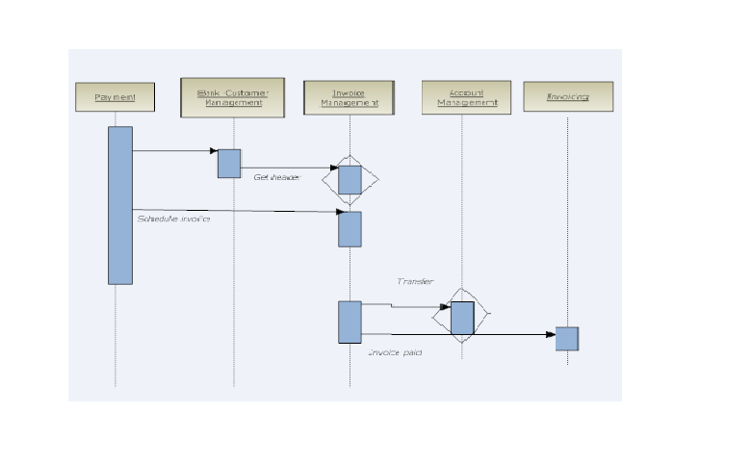
Figure 7.20 The grayed rhomboids highlight activities that provide input from the superordinate design model when defining superordinate use cases in the Invoice Management and Account Management.

Slide 67
7.12 wrapping legacy systems to fit the architecture
we have to consider how to integrate our new application and component system with existing systems.
In most situations when a reuse business is installed, there already exist significant legacy systems that do part of what the new application should do.
A legacy system is a pre-existing system that was created using other design methods and technologies, yet still manages significant business data and continues to support important business processes.
There are a number of possible approaches to take when dealing with legacy systems, but we will only consider reuse of legacy systems by wrapping them in new technology.
This allows an incremental approach to replacing or upgrading the legacy systems.

Slide 68
wrapping legacy systems to fit the architecture
A wrapper is here a piece of object-oriented software that encapsulates the legacy system and manages some interactions with it.
In the RSEB this is done by creating one or several separate component systems for each legacy system to be wrapped.
These component systems will provide an appropriate set of objects and operations to create, fetch, store, and manipulate objects corresponding to data and procedures in the legacy system.
Tool such as the ParcPlace- Digitalk PARTS Wrapper can do some of this work, but an efficient design and implementation of the encapsulation can become a significant effort in itself.

Slide 69
Example
As XYBsoft begin to develop their suite of application systems, they decide to base it on their existing Customer-Account Transaction Manager, developed in COBOL 20 years ago. The system contains critical business data regarding accounts and customers that can be accessed through the low-level interfaces Account Data and Customer Information. Since the application family engineering team wants to be able to evolve account and customer management independently, they choose an architecture with two component systems, Account Management and Bank Customer Management. They therefore define these component systems together with suitable interfaces to Account and Bank Customer and let each wrap different aspects of the legacy system, in the future they expect to move from the existing Customer-Account Transaction Manager to new technology.

Slide 70
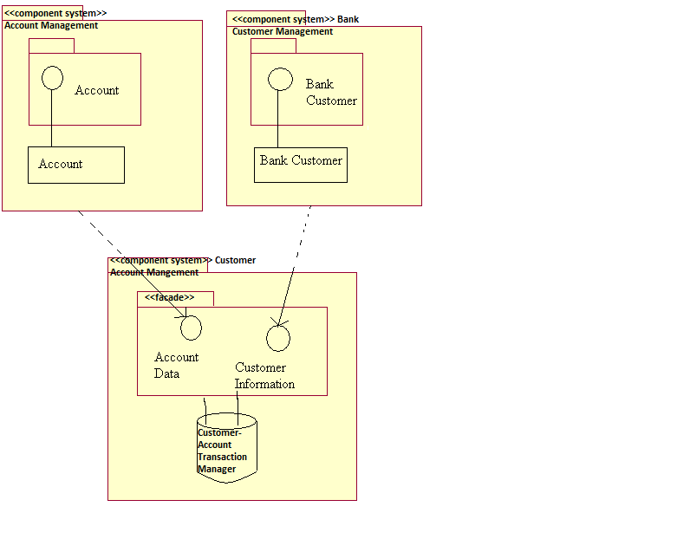
Figure 7.21 Account Management and Bank Customer Management wrap the legacy system Customer-Account Transaction Manager

Slide 71
7.13 distributed processes and nodes for a layered system
A distributed system is one with several simultaneously advancing computations, possibly synchronizing and communicating. A distributed system is said to be parallel if the “simultaneously advancing computations” overlap in time.
A process is used to represent a single “advancing computation” in most computing environments; that is, a thread of control in a computing environments that can be carried out concurrently with the threads of control represented by other processes.
An example of a thread of control is the main function in C++. We define the behavior of a process as the behavior defined for its thread of control. A heavyweight process can “contain” (or create) other smaller lightweight processes or threads, whose programs cooperate to perform some behavior.

Slide 72
distributed processes and nodes for a layered system
For each new process added to system it becomes even harder to understand and engineer. Thus, distributed systems are in most cases harder to develop compared to sequential systems consisting of only one processes.
A node represents an abstraction of a hardware device in the system’s implantations. A node is used to describe one node type, for example a computer or a device, in a physical network that executes the system’s functionality.
Processes are allocated to nodes; processes that are allocated to the same node are (physically) distributed together in the system’s implementations.
When objects are allocated to processes, their (instances) reside in the same address space as the process.
Objects of a single type or class can be allocated to different processes.
Objects of different types or classes can be allocated to the same process.
Another aspect of distribution is that multiple application systems may share objects at run time.

Slide 73
Example
It is often convenient to have separate processes for dealing with different actors. The Payment and Invoicing application involves different actors which can operate fairly independently since they only interact through Invoices that change state. The application systems are furthermore often implemented on different hardware. They should therefore be allocated to different processes. the Account and Invoice objects could be shared in a distributed environment by using an object request broker. The Payment and Invoicing applications then import the interfaces to those component systems and use the objects as if they were available in the same process as the application itself.
The architects believe that later they want to allow the Account and Invoice objects to be located anywhere in their distributed system, as long as they are reachable through the ORB. But for the first few releases they releases they decide that these objects belong entirely to the same process as the legacy system Customer-Account Transaction Manager. From an architectural point of view they can think of the legacy system as executing with in one single process

Slide 74
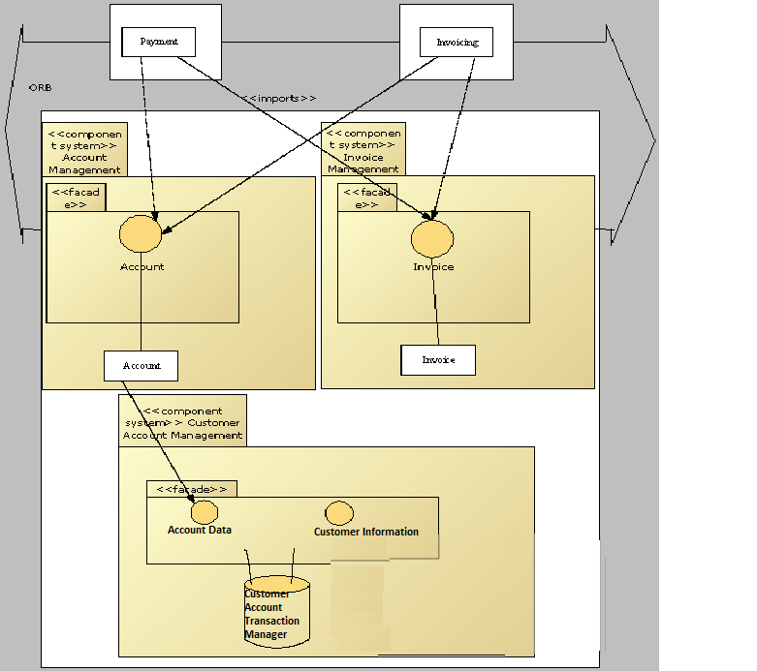
Figure 7.22 Payment and Invoicing are both allocated to independent processes. Account Management and Invoice Management are both allocated to a common legacy system process. An ORB marshals and forwards requests between these processes

